Slide 1

Marathwada Mitra Mandal's
COLLEGE OF ENGINEERING, Karve Nagar, Pune - 52
An Autonomous Institute Affiliated to SPPU
Website: www.mmcoe.edu.in email id: mmcoe@mmcoe.edu.in
Department of Information Technology
Project Based Learning - Review 1 (AY 2025-26)
“Emergency Service Platform”
Presented By: SI145 Harshwardhan Khaire
SI138 Pranav Chavan
SI141 Sonal Karche
SI126 Sanika Potdar
Name of Guide:
Dr. Prakash Gadekar
Name of Sponsor: (If applicable)
Date:

Slide 2
CEP Project Title
Emergency Service Platform
Context of the project : In emergencies, people struggle to find and contact the right service quickly. Delays in reaching fire, police, ambulance, or roadside assistance can cost lives and property. A single app integrating all emergency services can bridge this gap. Area/Community of focus : Urban communities, where response time is critical.

Slide 3
Recap of Selected Problem
Problem Statement : Emergency response today is slow and fragmented, relying on phone calls and manual coordination. This causes delays, miscommunication, and limited support from NGOs/volunteers—leading to panic and preventable harm. Our project bridges this gap with a fast, digital, location-aware solution.
Objectives:
Develop a one-stop digital platform for requesting multiple emergency services (ambulance, police, fire, NGOs).
Automate and digitize communication between users and service providers.
Enable real-time GPS location sharing to reduce response delays.
Provide transparency with live status updates (“Accepted”, “On the Way”, “Resolved”).
Engage volunteers and NGOs to support official services in emergencies.
Ensure efficient case management for providers via dashboards and reports.

Slide 4
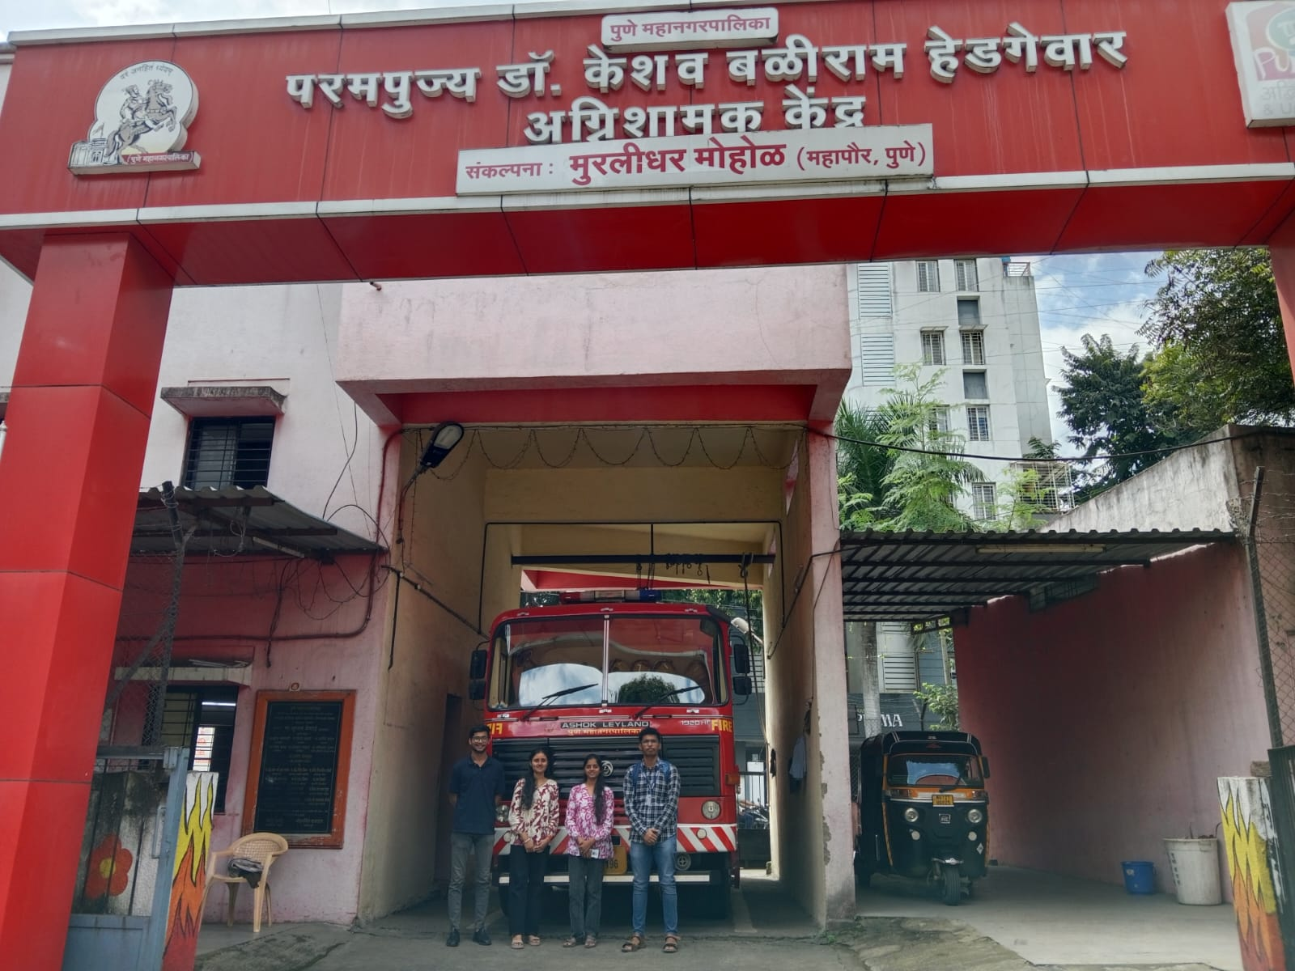
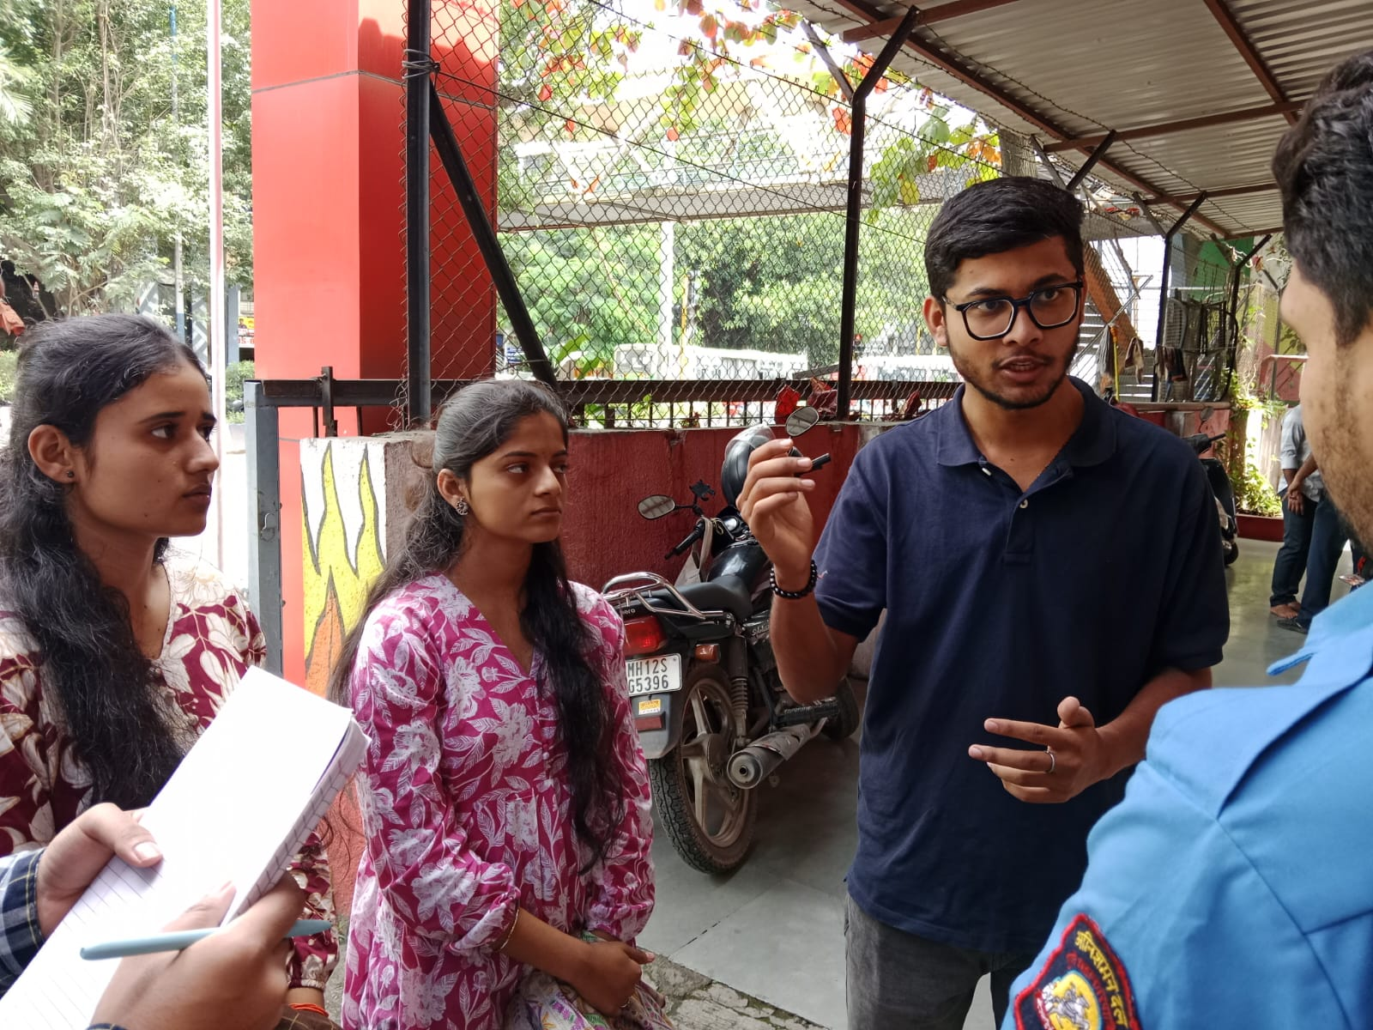
Community/ Field Visit
Area visited:
Kothrud Fire Station
Shashwat Hospital
Warje Malwadi Police Station
People consulted (photos if applicable)
Aniket Uttekar (Fire Station Employee)

Slide 5
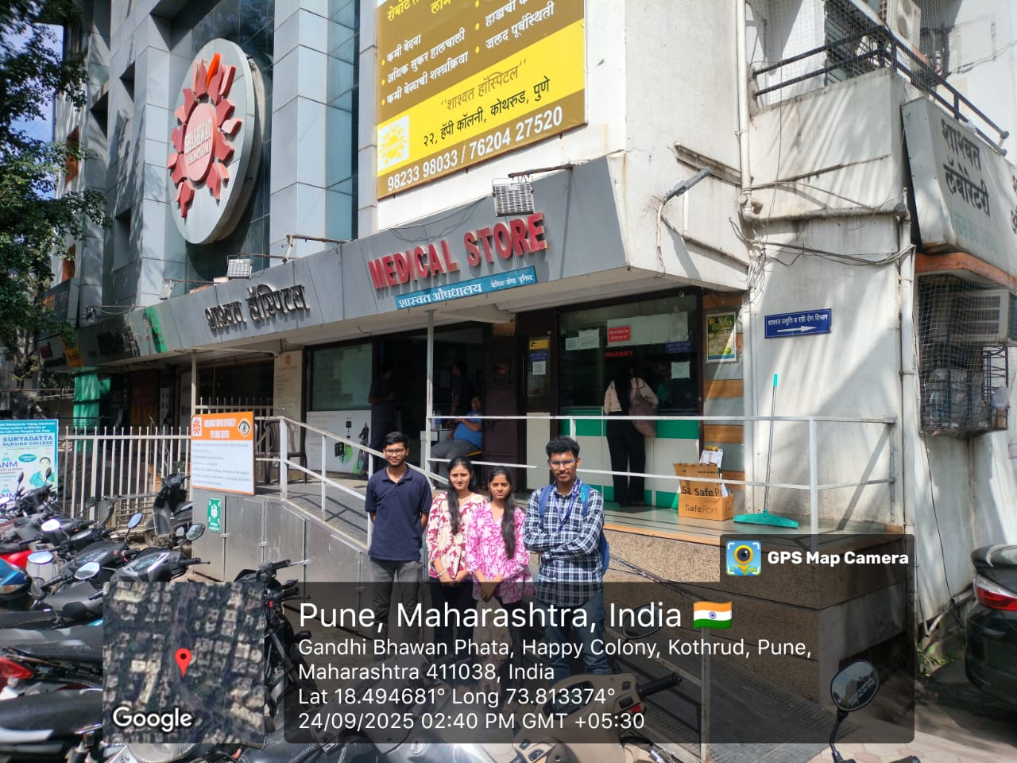
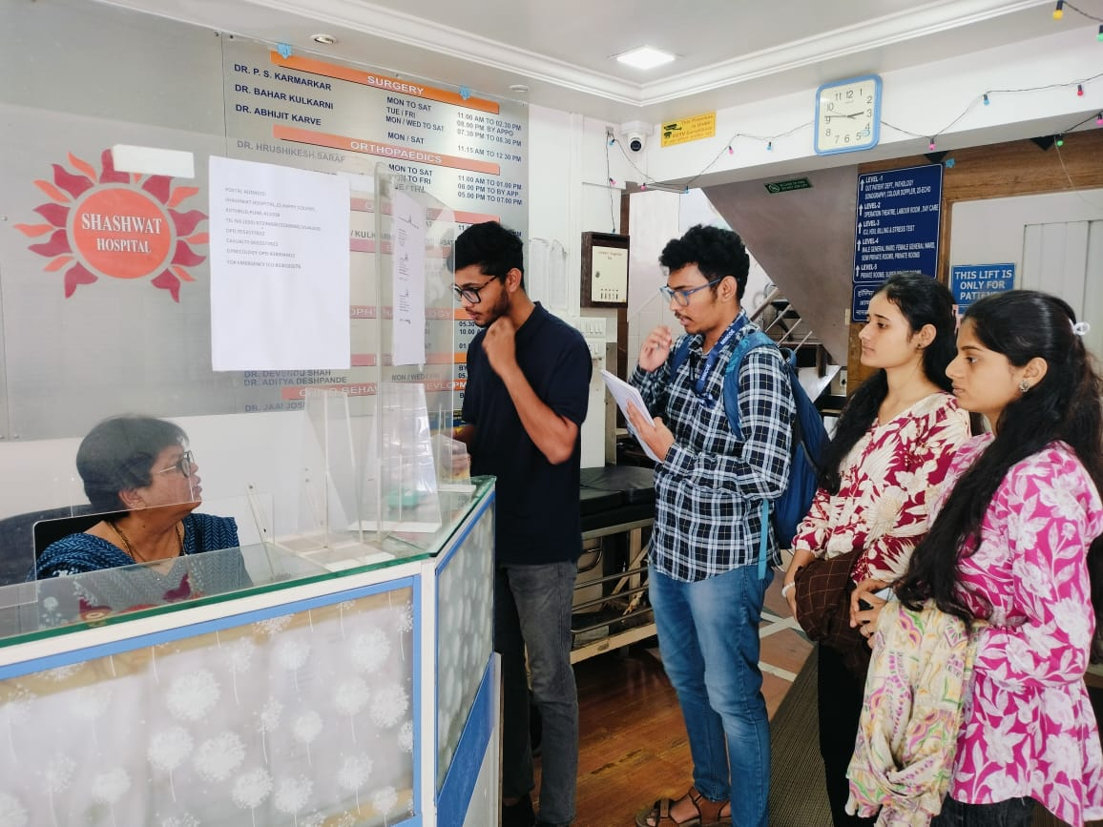
Community/ Field Visit
2. Dr. Varsha C.(Shashwat Hospital Manager)

Slide 6
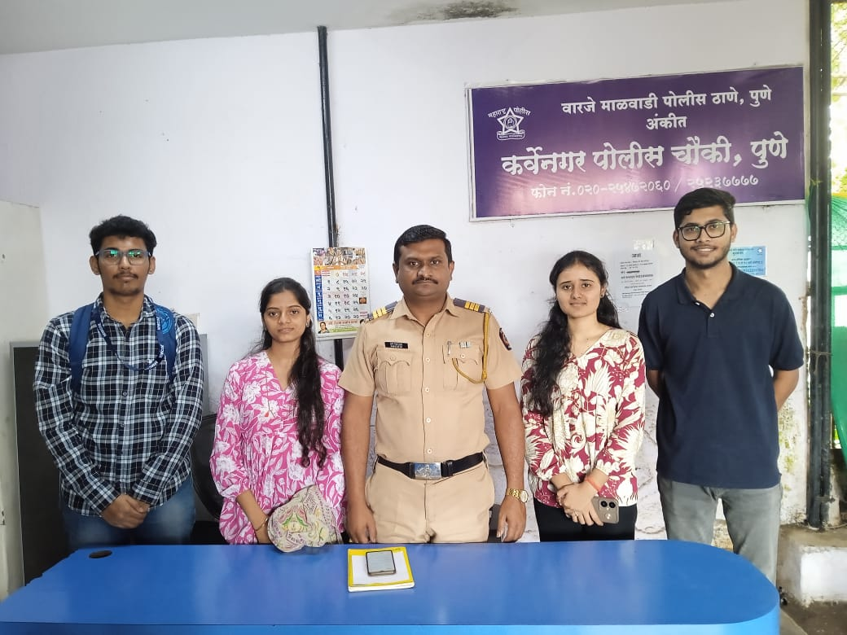
Community/ Field Visit
3. B.P. Ingole (Inspector at Warje Malwadi Police Station)

Slide 7
Community/ Field Visit
Observations (Table Format):
Location | Observations
Fire Station | Multiple stations may respond simultaneously, causing confusion. No information about presence of explosives or hazardous materials at the site.
Hospital | Missing relative/guardian information. No proper patient verification during emergencies. Lack of decision-making authority for critical patients
Police Station | Network and range issues hinder communication. Difficulty in accurate real-time location tracking.

Slide 8
Data Collection and Analysis
Survey results, interviews:
  Emergency services in our area are generally effective.
  Major issues like traffic delays depend on other authorities.
  Minor issues such as network connectivity can be addressed through our project.
Key Patterns:
Emergency services operate through a central hub (commissioner office for police station) .
A central authority coordinates communication between emergency personnel and the resolving organizations.
The system functions like a tree, where the central hub directs requests to the appropriate branch of the emergency service.
Insights drawn:
Traffic delays and location miscommunication are the biggest causes of slow emergency response.
ESP can reduce average response time from 18 minutes to 8 minutes, improving efficiency by over 50%.
NGOs and volunteers are underutilized but can play a vital support role when integrated into the system.

Slide 9
Constraints and Challenges
Constraints & Challenges Identified:
Fire Station:
Confusion when multiple stations receive the same emergency alert.
Lack of information about hazardous materials/explosives at the incident site.
Hospital:
No clear decision-maker for critical patients.
Absence of patient verification or medical history access during emergencies.
Missing details about patient relatives/contacts, making communication and consent difficult.
Police Station:
Limited or unstable network connectivity, causing response delays.
Inaccurate or missing real-time location tracking of incidents.

Slide 10
Ideas for Possible Solutions
Mobile App (Android + iOS):
One-tap SOS button with live location sharing.
Dedicated Service Modules: Separate workflows for Fire, Police, Ambulance.
Separate service modules make it easy for users to directly reach the right service, while the centralized dashboard ensures that authorities can coordinate faster.

Slide 11
Q and A

